Slide 1


Shadow Neural Radiance Fields for Multi-view Satellite Photogrammetry
Author: Dawa Derksen
Presented By : Megh Patel
[megh.p@ahduni.edu.in]
School of Engineering and Applied Science
20 March 2026

Slide 2

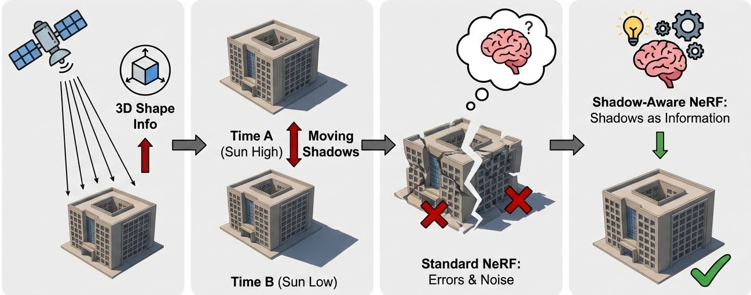
Introduction & The Challenge
Source: Image generated on 18 March 2026 | Gemini 3 Pro Image-Preview

Slide 3
Introduction & The Challenge
Source: Image generated on 18 March 2026 | Gemini 3 Pro Image-Preview

Slide 4
Introduction & The Challenge
Source: Image generated on 18 March 2026 | Gemini 3 Pro Image-Preview

Slide 5
Introduction & The Challenge
Source: Image generated on 18 March 2026 | Gemini 3 Pro Image-Preview

Slide 6
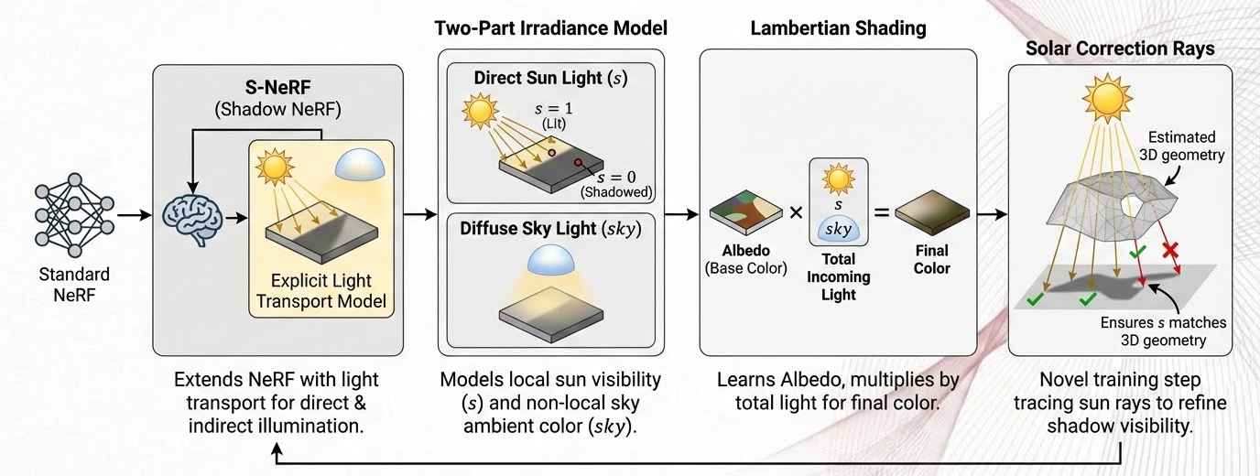
Proposed Methodology (S-NeRF)
Source: Image generated on 18 March 2026 | Gemini 3 Pro Image-Preview

Slide 7
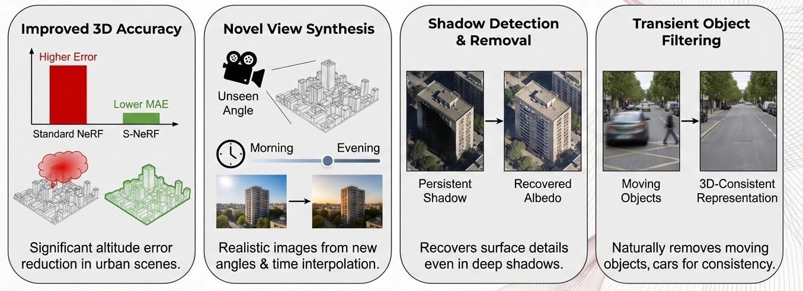
Results and Key Takeaways
Source: Image generated on 18 March 2026 | Gemini 3 Pro Image-Preview

